Slide 1

Emotion-Aware Adaptive Study Assistant
Enhancing Learning Through Emotional Intelligence

Slide 2





The Challenge We're Addressing
High Dropout Rates
Engagement Drop-off
Significant attrition during exam preparation cycles, especially after initial enthusiasm fades
Student participation declines noticeably after 3–4 weeks of platform usage
Stress During Mock Tests
Static Chatbots
Peak anxiety during practice exams leads to test abandonment and platform disengagement
Current text assistants lack emotional awareness and respond with fixed, impersonal patterns

Slide 3
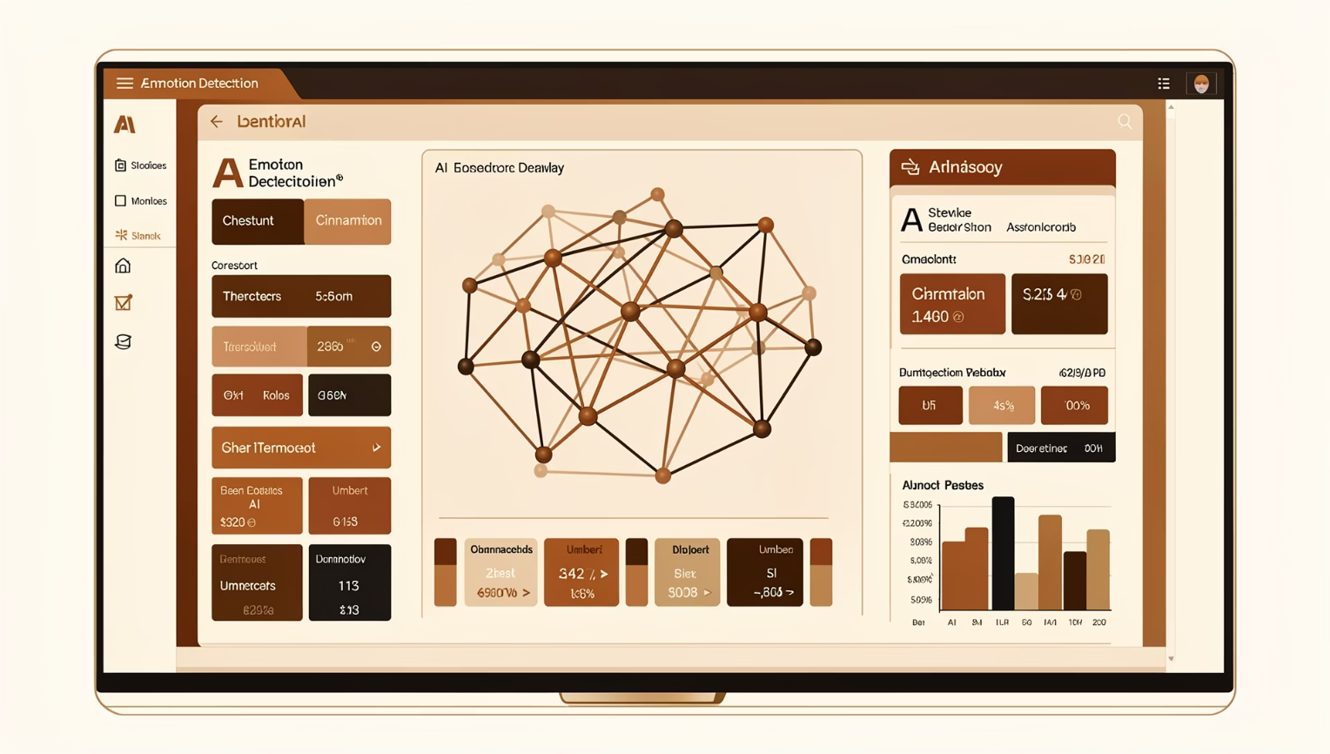
Intelligent Solution: Adaptive Emotional Support
How It Works
An AI-driven conversational assistant that detects student emotions from text—frustrated, confused, anxious, confident, or neutral—and adapts its tone and explanation style dynamically.
The system provides supportive academic guidance while carefully avoiding medical or psychological claims, staying within educational boundaries.
01
02
Emotion Detection
Adaptive Response
ML model analyzes student text input for emotional cues
System adjusts tone, depth, and explanation style
03
04
Context-Aware Guidance
Continuous Learning
Responses tailored to subject matter and difficulty level
Improves accuracy through feedback loops

Slide 4

System Architecture
Student Input
Emotion Classifier
Adaptive Engine
LLM Response
Chat Interface
Emotion Classifier
Web/mobile interface capturing student queries and text input
Machine learning model trained to detect emotion from text patterns
Adaptive Response Engine
LLM Response Generator
Logic layer mapping emotion to appropriate tone and strategy
Large language model produces contextually appropriate academic responses

Slide 5
Emotion-to-Response Mapping
Detected Emotion
Response Tone
Adaptive Strategy
Frustrated
Supportive, patient
Break problem into step-by-step explanation with validation checkpoints
Confused
Clear, structured
Provide simplified examples with visual analogies and foundational concepts
Anxious
Encouraging, reassuring
Offer structured action plan with achievable milestones and progress tracking
Confident
Motivating, challenging
Present advanced problems and enrichment materials to stretch capabilities
Neutral
Professional
Standard academic explanation at appropriate difficulty level

Slide 6


Model Evaluation & Expected Impact
Performance Metrics
≥85%
Target F1-Score
Harmonic mean of precision and recall across all emotion categories
Accuracy, precision, recall targets ensure reliable emotion detection before deployment.
25%
15%
Engagement Increase
Dropout Reduction
Expected improvement in platform interaction and study time
Anticipated decrease in stress-driven platform abandonment

Slide 7
Future Enhancements & Timeline
Phase 1: MVP
Phase 3: Learning Paths
Text-based emotion detection with GPT integration
Personalized curriculum based on emotional patterns
1
2
3
4
Phase 2: Voice Analysis
Phase 4: Adaptive Scaling
Voice tone detection for richer emotional understanding
Dynamic difficulty adjustment based on confidence

